Slide 1
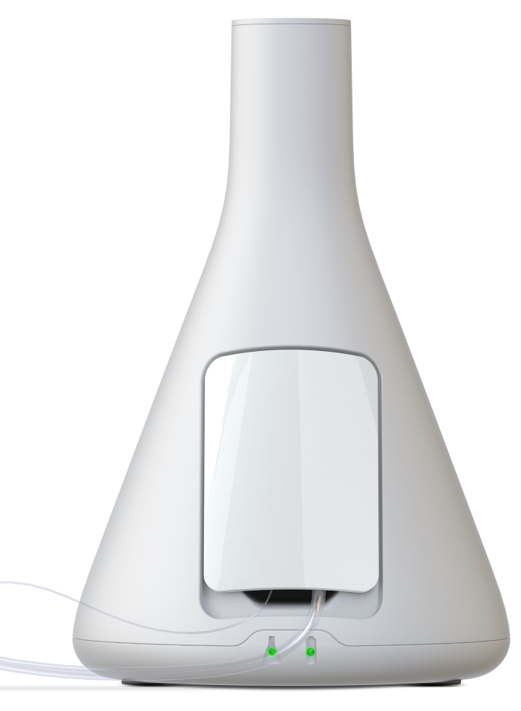
Tommorow Today
”When using microdialys you can forsee what later will become the clinical signs, thats what we at M Dialysis consider ”Tomorrow Today”
Olof Nord, CEO M Dialysis AB

Slide 2
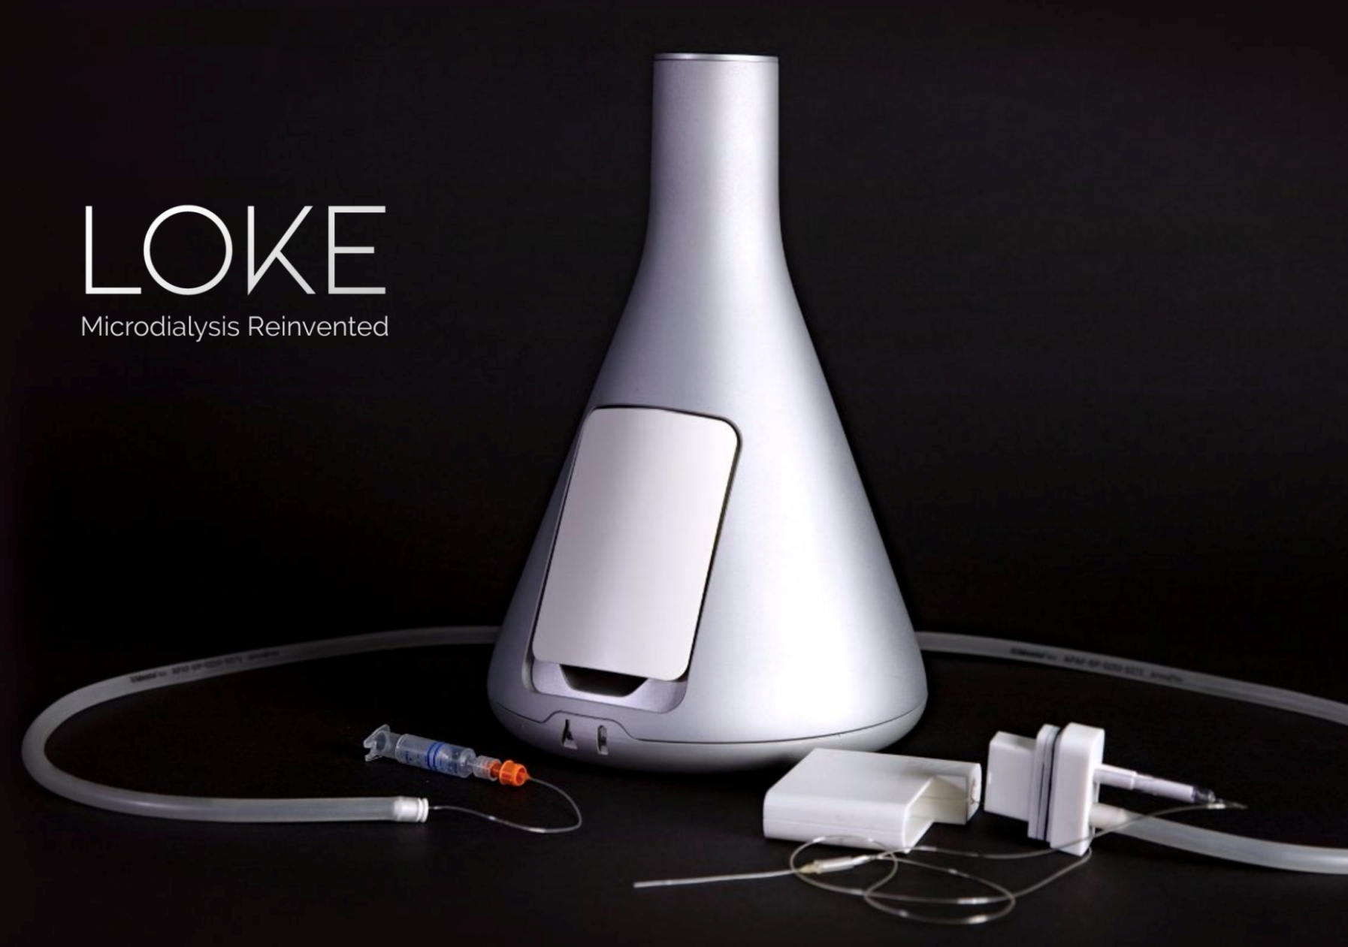
MD System, Loke - Microdialysis in real-time
Automated plug & play system
Continuous monitoring of:
Glucose
Lactate
Pyruvate

Slide 3
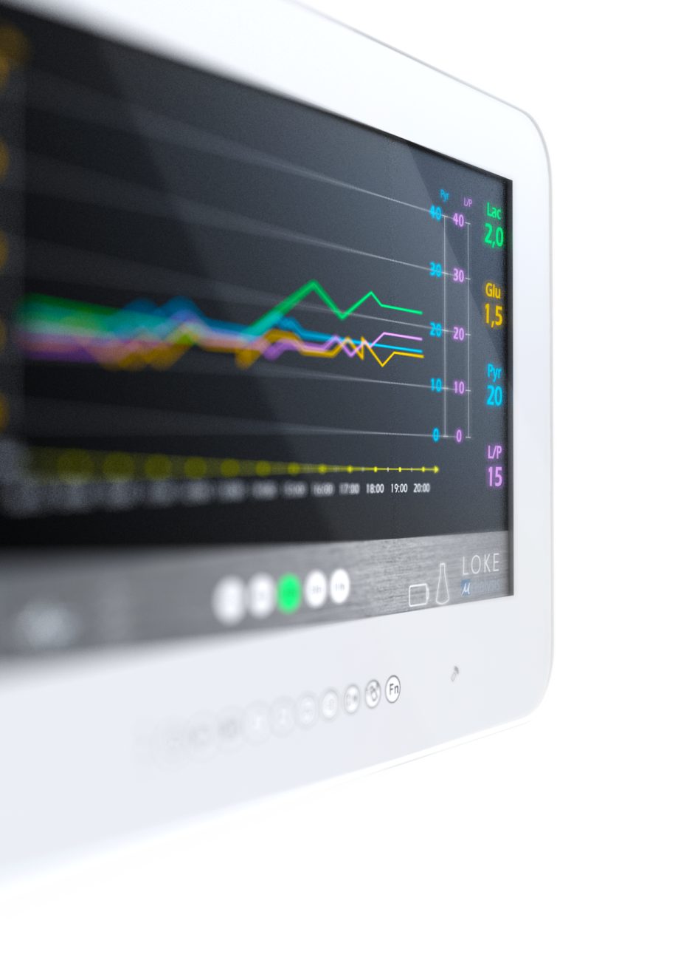
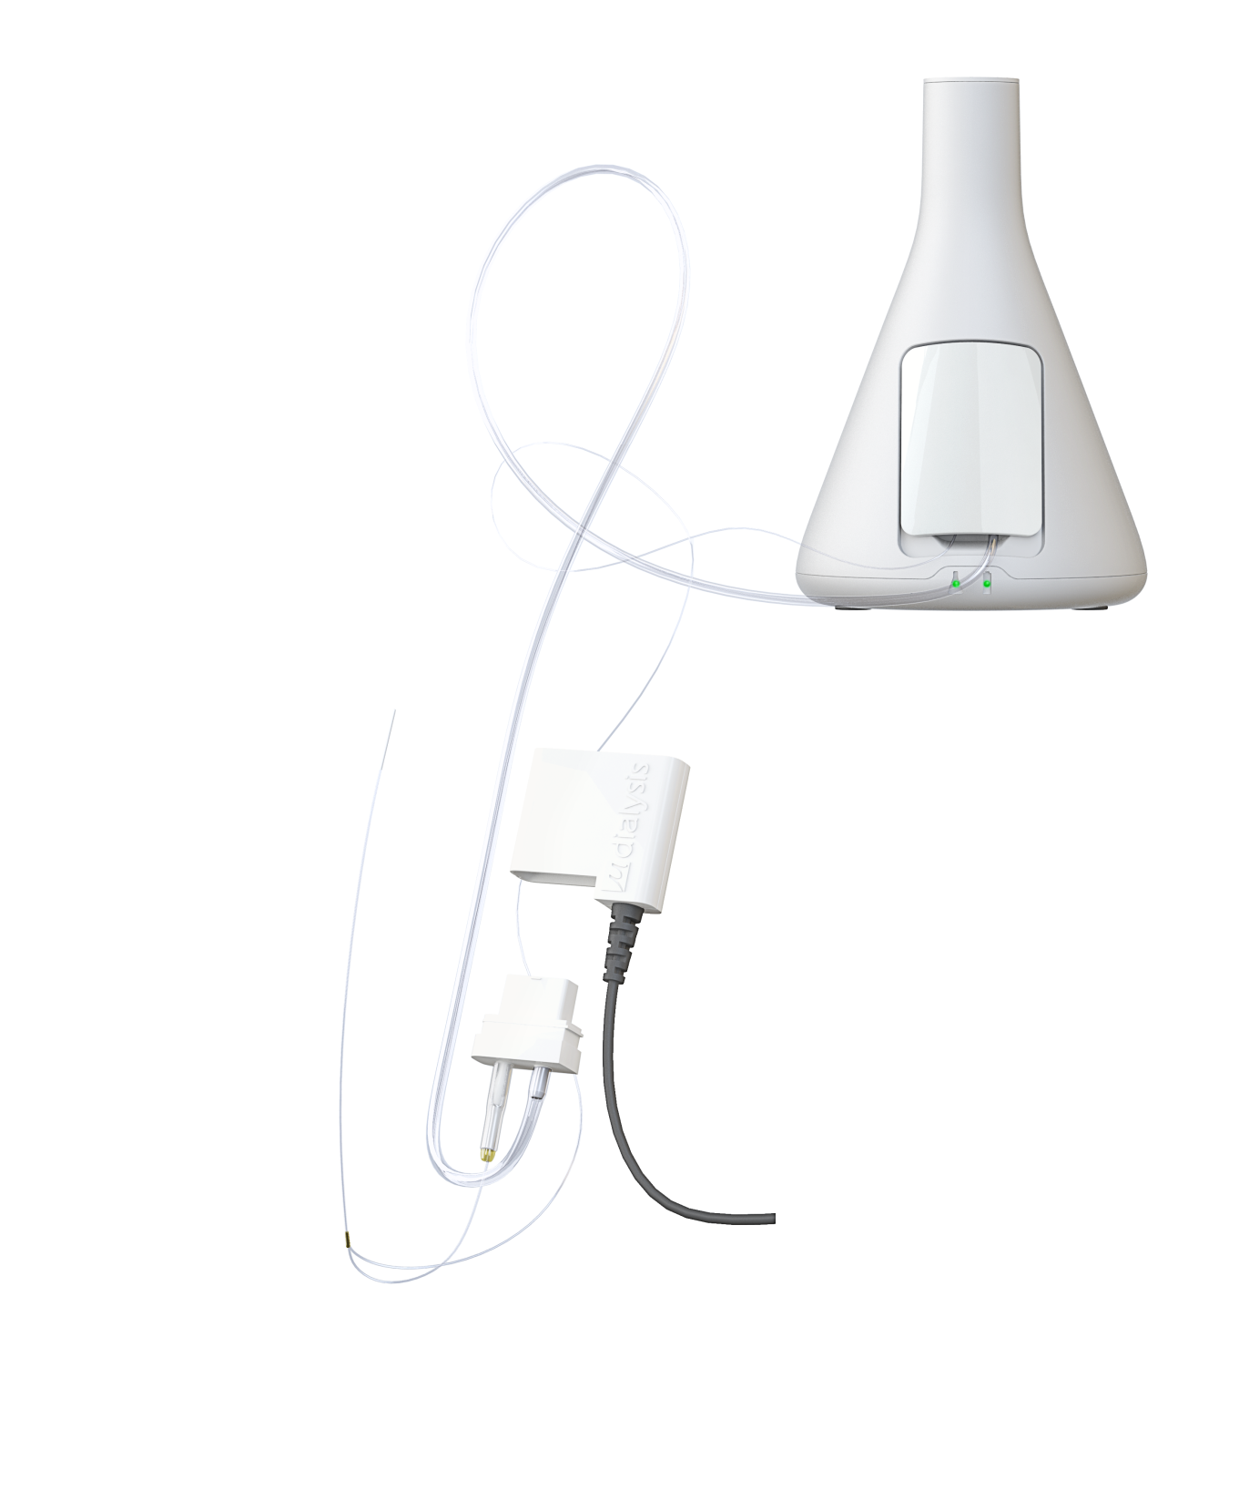
MD System, Loke
MD Unit
MD Catheter
MD Amplifier
MD-Monitor
MD Biosensor

Slide 4
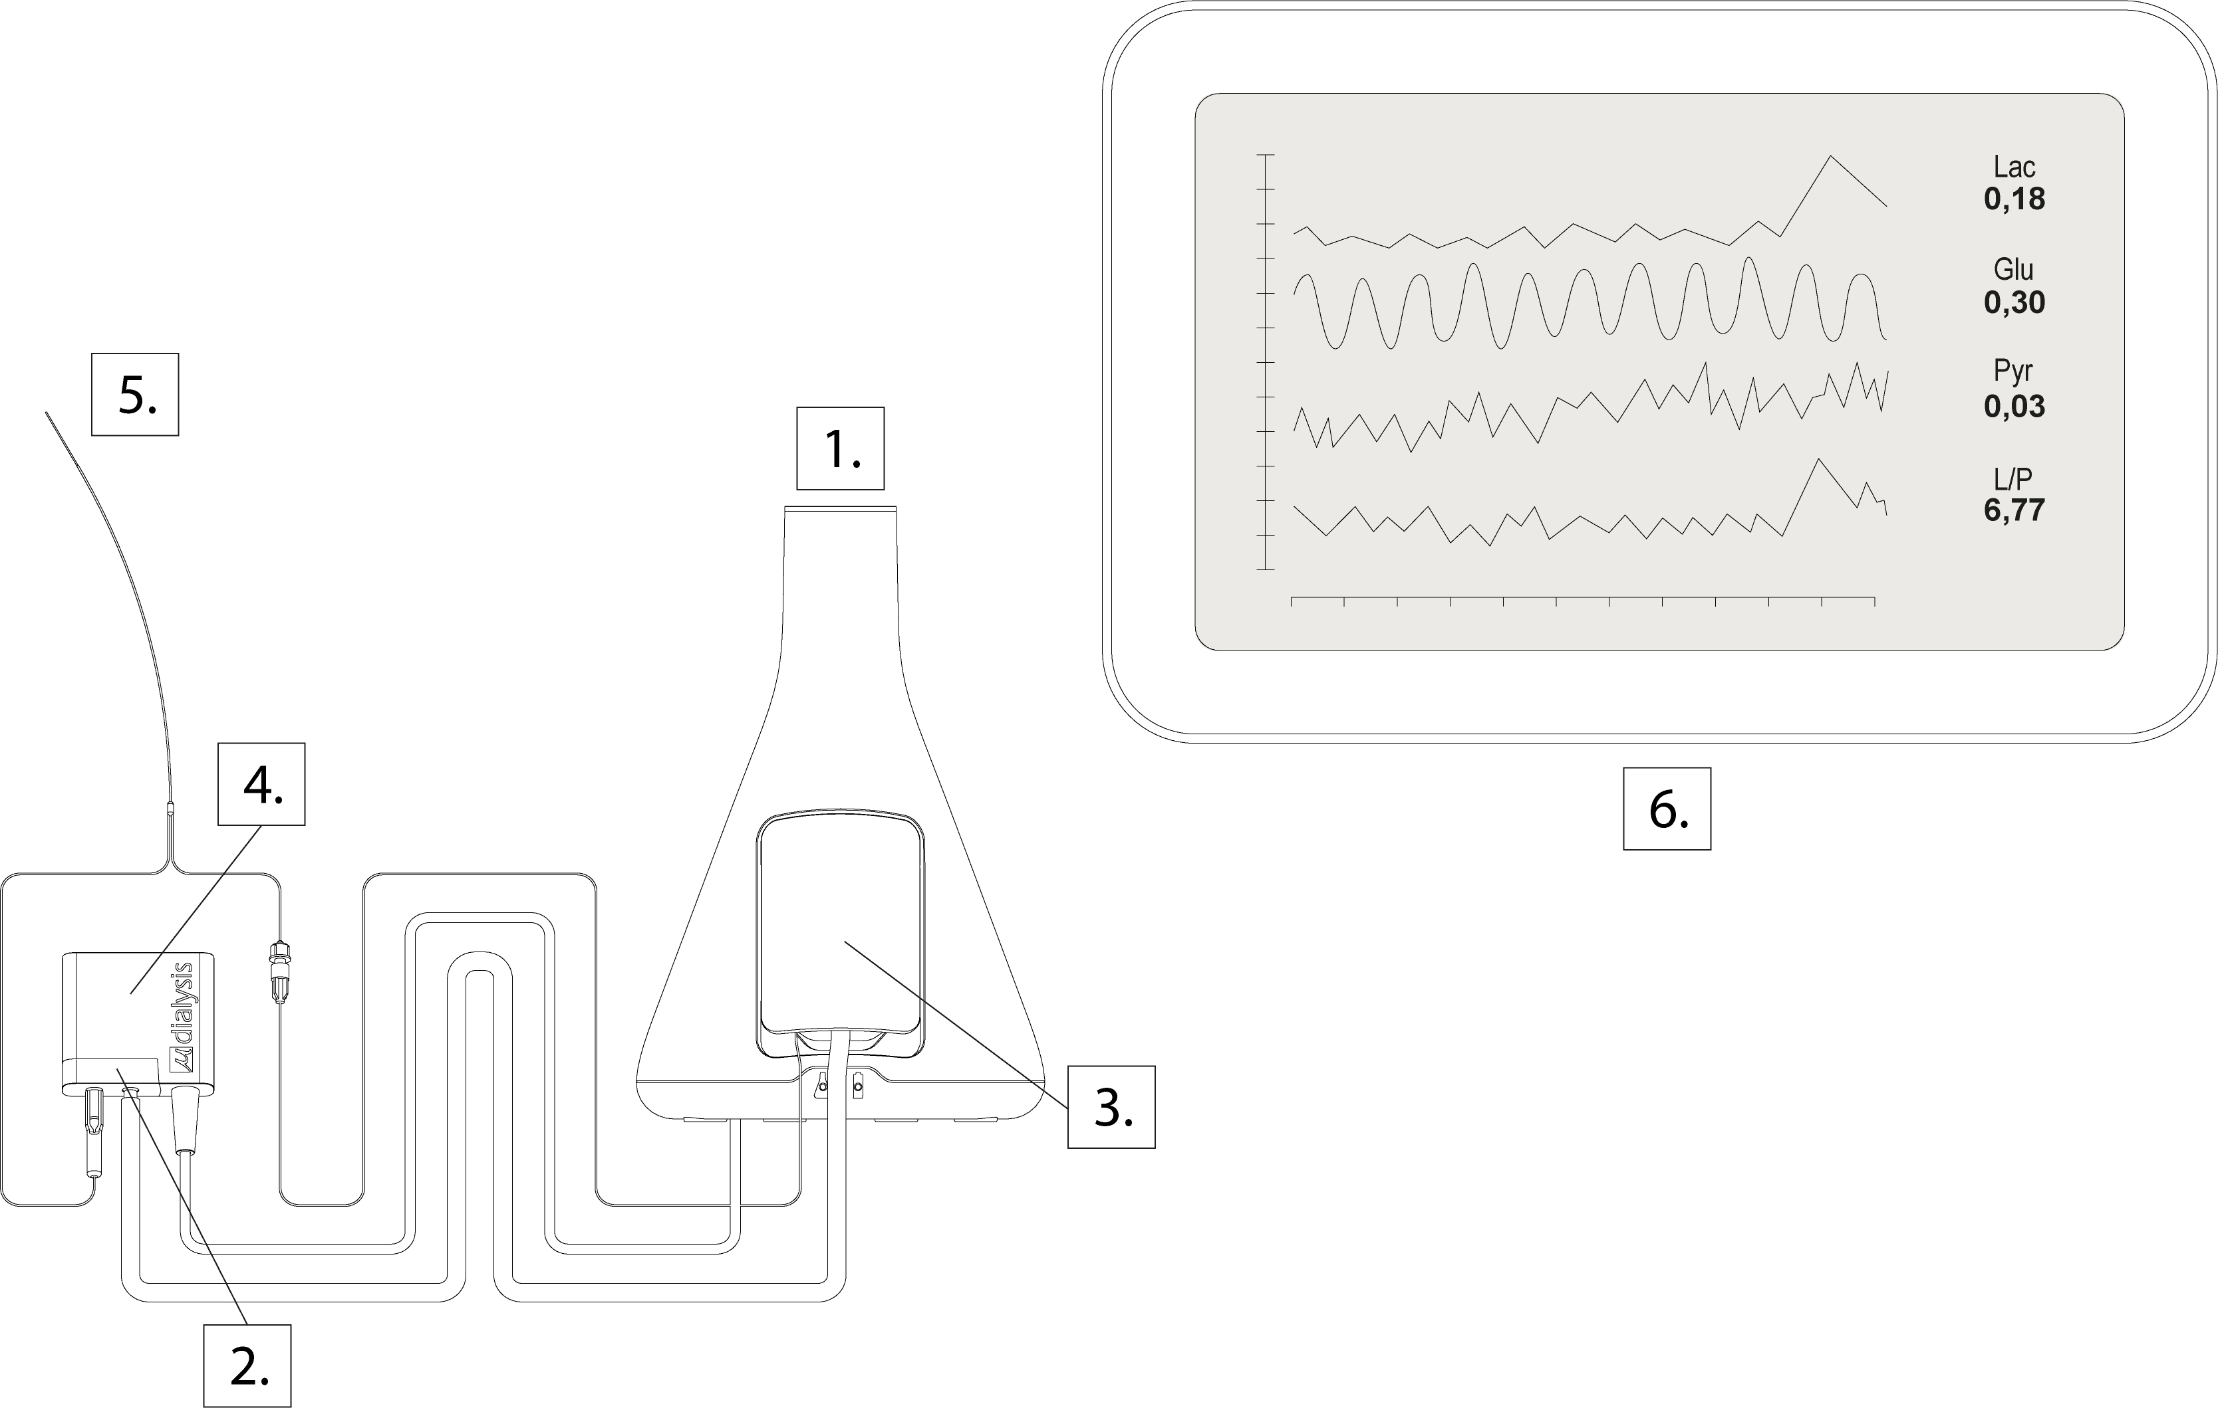
MD System Loke, overview
1
MD Unit: power supply, syringe pumps & computer
MD Sensor: Biosensor & tubing's
MD Cartridge: interface for the MD Unit and a syringe retainer
MD Amplifier: amplifier with cable
MD Catheter: eg. 70 Brain MD Catheter, 63 MD Catheter and others
MD Monitor :Touch panel Windows PC with integrated monitor

Slide 5
MD System main functions:
A controlled flow of perfusion liquid to the Microdialysis Catheter.
A controlled flow for Calibration fluid to perform calibrations regularly (6h).
A Biosensor that converts the content in the microdialysate to an electric current.
An amplifier that amplifies the signal from the biosensor.
Analysis software that displays the signal from the biosensor at the MD Monitor.

Slide 6
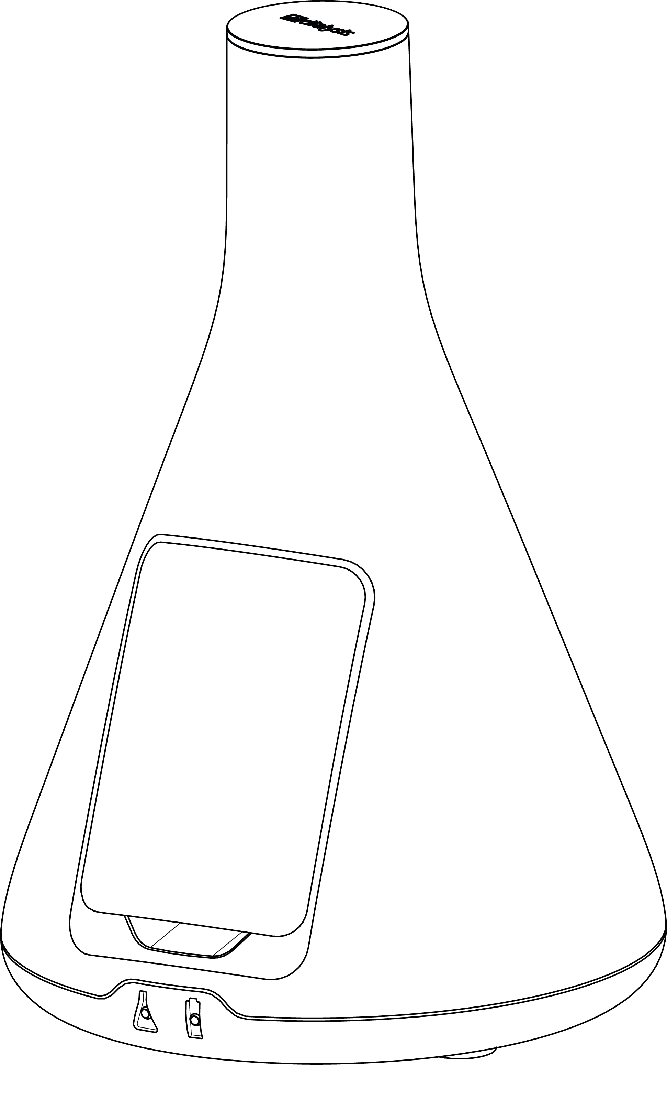
MD Unit
Central unit containing process control and analyzing unit
MD Unit
MD Cartridge
Function indicators for MD System and battery

Slide 7
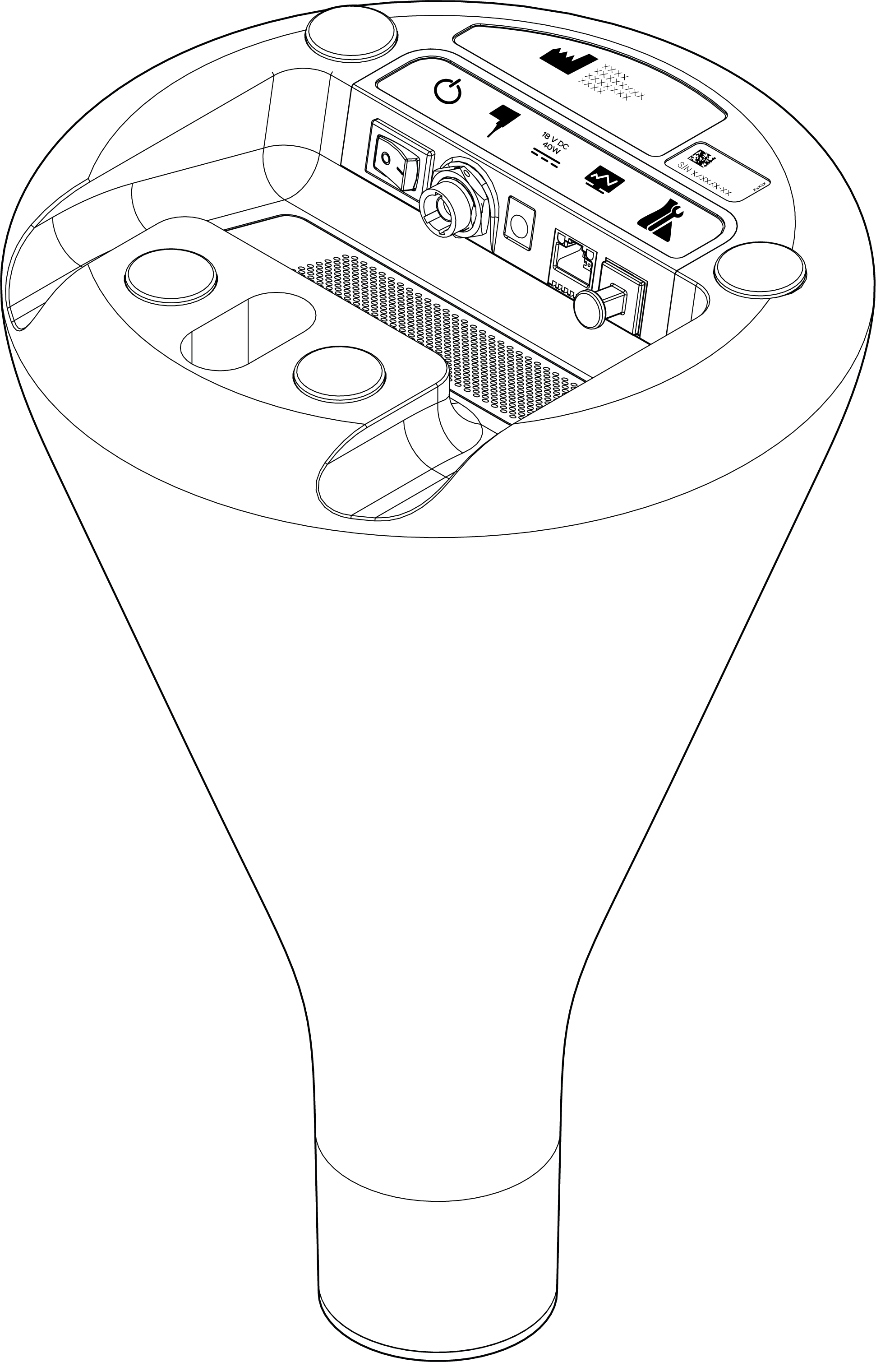
MD Unit parts
MD Unit label –
Serial number
MD Amplifier port
Power supply port
ON/OFF switch
MD Monitor port
Service port (plugged)
Interface for MD Unit Holder

Slide 8
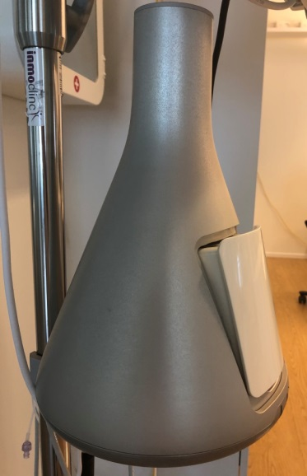
MD Cartridge
Part containing filled syringes connected to the MD Sensor. The MD Cartridge is, prepared with syringes, inserted in the MD Unit and the syringes are actuated by the Pietzo syringe motors.
Orange syringe
with MD Calibrator
106 syringe (non-colored piston)
with perfusion fluid
MD Cartridge

Slide 9
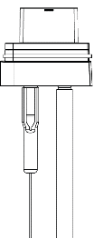
MD Sensor
Is a part containing biosensors that continuously measures Glucose Lactate and Pyruvate in the Microdialysis catheter out flow.
MD Sensor
Catheter Connection (Microvial holder)
Tubing to MD cartridge

Slide 10
MD Monitor
consisting of a pre-configured Touch Panel Windows PC with integrated monitor and a power supply unit.

Slide 11
Applications for MD System Loke
Neuromonitoring
70 MD Bolt Catheter-Implantation via Bolt
70 Brain MD Catheter- Implantation via tunnelation
67 Intravenous Microdialysis Catheter-Jugular bulb monitoring/CSF monitoring
Monitoring in Adipose tissue or Resting skeletal muscle
63 Microdialysis Catheter
Microsurgical Flaps monitoring (Reconstructive surgery)
63 Microdialysis Catheter
Peripheral Vein monitoring
67 Intravenous Microdialysis Catheter

Slide 12
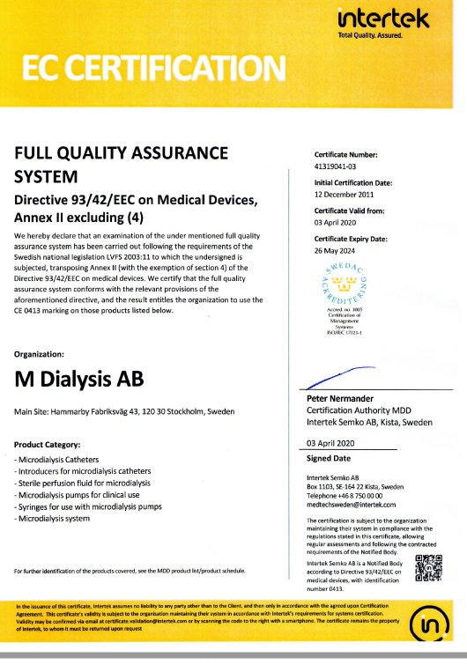
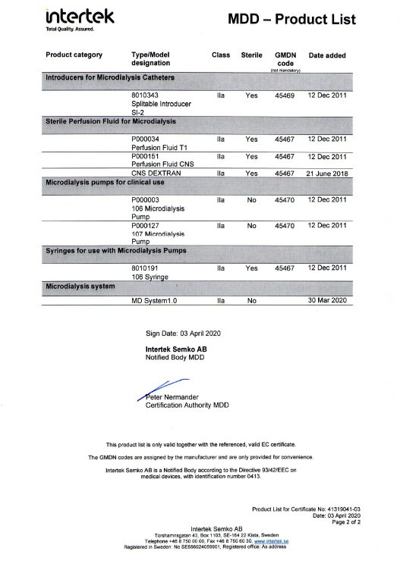
CE approved as a Class IIa Medical Device

Slide 13
Centers already invested in the new technology
Lunds University Hospital, Sweden
Kepler Uniklinikum , Linz, Austria
Karolinska Hospital, Solna, Sweden
Academic Hospital, Uppsala, Sweden
Örebro University Hospital, Sweden

Slide 14
Ordering Information
REF Description Unit
8070228 MD System 1 pc
incl: 8070014 MD Unit, 8070088 MD Unit Holder, Test sensor
8070151 MD Cartridge, 8070198 MD Amplifier, Users Manual
8070223 MD Monitor (with selected option of attachment, see below)
Options for attachment of MD Monitor;
8072019 MD Monitor arm Standard runner
8072020 MD Monitor arm Pole
8072029 MD Monitor Deskstand
8072038 MD Monitor Holder
8050187 MD System Sensor LPG kit 1 pc
incl: 8070203 MD Sensor LPG, 8072001 Catheter Extension
8050181 MD System Syringe kit , Brain Tissue 1 pc
incl: 1 106 Syringe, 1 Orange Syringe ,1 Perfusion Fluid CNS, 1 MD Calibrator
8050182 MD System Syringe kit , Perip Tissue 1 pc
incl: 1 106 Syringe, 1 Orange Syringe ,1 Perfusion Fluid T1, 1 MD Calibrator
8070081 Syringe Orange 20/pkg
8072009 MD Calibrator 2x5mL
8070198 MD Amplifier 1 pc

